Slide 1

Production Worksheet And
Production Records for FSD Staff
Provided by the LAUSD Food Services Division
Notes:
TELL: Welcome to the Production Worksheet and Menu Production Record training. As FS Managers, it is our job to confirm the information recorded is accurate, to be in compliant with the State and Federal regulation, and for audit purposes.

Slide 2
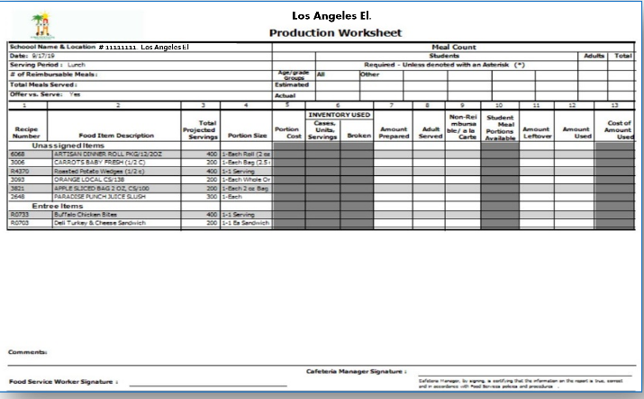
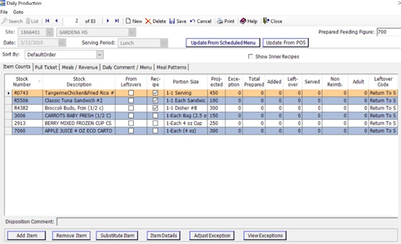
Overview
During this session, Food Services staff will acquire the skills to fill out the
Production Worksheets and Production Records.
Topics that will be covered during the session are as follows:
Completing a Production Worksheet and Production Record
How to complete a Production Record in CMS
Who's responsible for entering information
How to substitute menu items
11111111
Los Angeles El.
Production Worksheet
Production Record

Slide 3

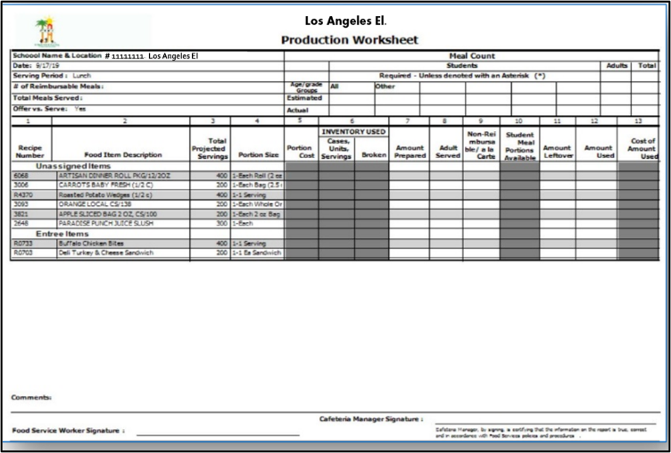
What is The Purpose of the Production Record?
Production Worksheets and Production Records are used to track meal production and ensure the school food authority is following policies and procedures for each meal service.
Production records are verified by the Federal government for accuracy to ensure site records are true representations of meal counts.
Audit Year

Slide 4



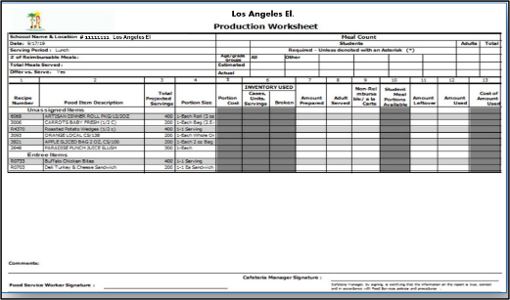
Production
Worksheet/Records Details
Production Worksheets and Production Records track the meal patterns for each meal service.
These records contain the following:
  Recipe number
  Food item descriptions
  Menu item serving size
  Age/grade nutrient standard over the school week
  Amount of reimbursable and
  non-reimbursable meals
  Food quantity prepared
  Leftovers
Amount Prepared
Amounts Tracked

Slide 5
PRODUCTION
WORKSHEET

Slide 6
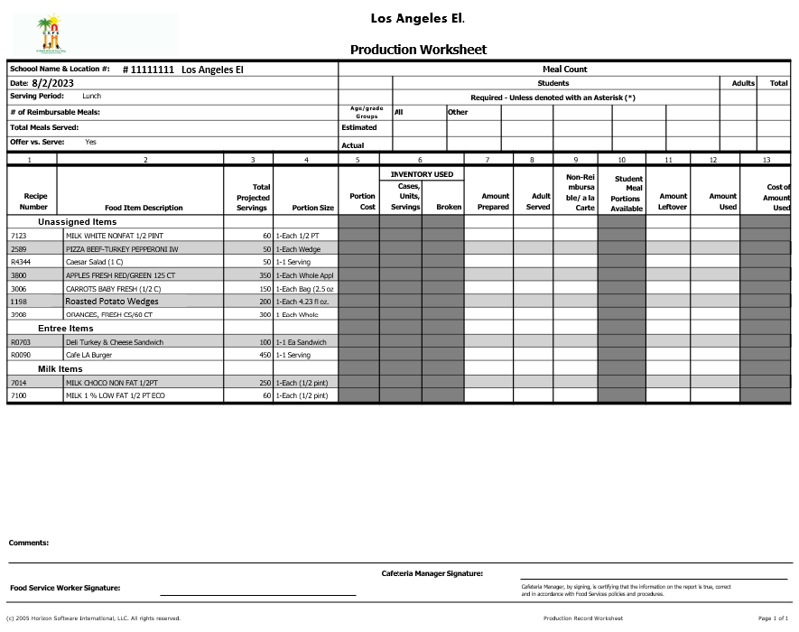
What is a Production Worksheet?
The Production Worksheet documents meals that have been prepared, cooked, served, and are leftover.
Production Worksheet information is transferred to the CMS Production Record after each meal service has been completed.
It is completed daily for each service.
8/19/2025
# 11111111 Los Angeles El

Slide 7
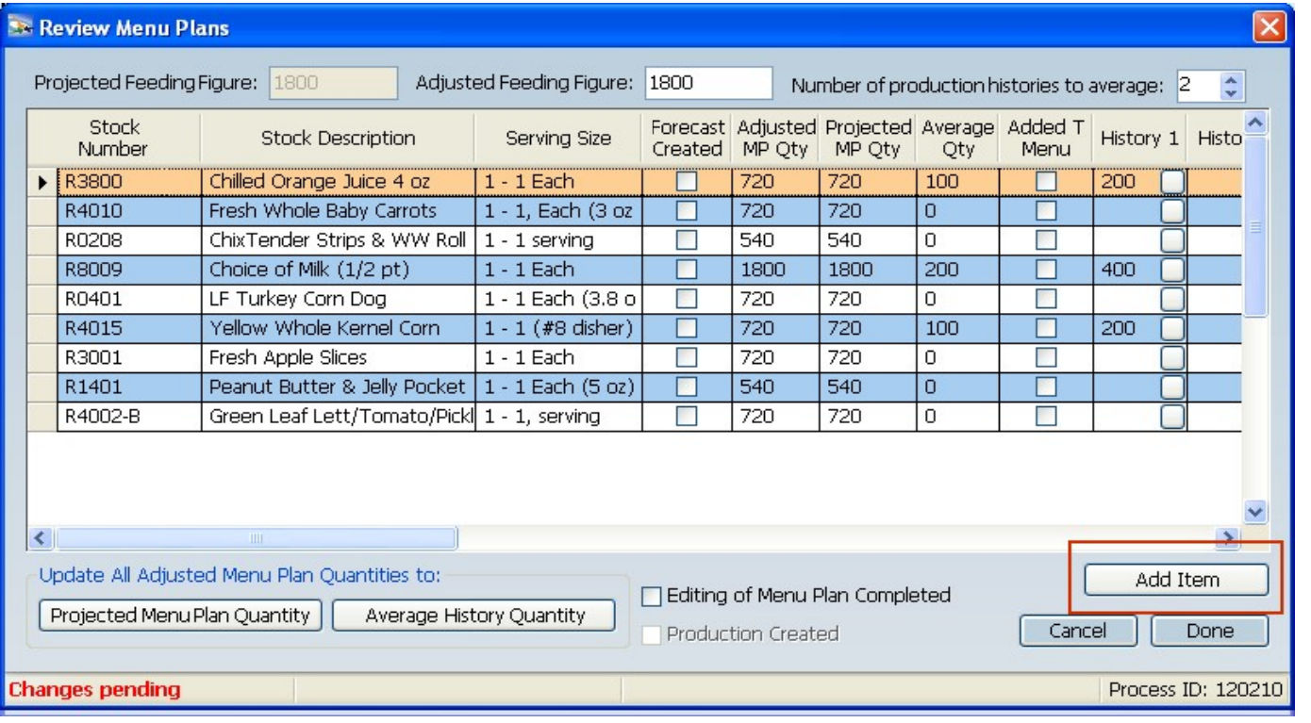
How are Production Worksheets Created?
Production Worksheets are created during the EZ-Steps process.
Based on the quantities entered during menu plans, these numbers will appear on the Production Worksheet.
These amounts are used by staff to prepare for service.
Week 1
Monday 8/18/25
Lunch
Lunch
Entrée 1
Chicken Tenders & Roll
540
Entrée 2
LF Turkey Corn Dog
720
Entrée3
Managers Choice
100
Entrée 4
Vegan
Peanut Butter
&
Jelly Pocket
540
Fruit ½ Cup
Apple Slices
720
Fruit Juice
Orange Juice 4oz
720
Vegetable
½ Cup
Whole Kernel Corn
720
Milk 8oz.
Milk 8oz.
1800

Slide 8
MENU
SUBSTITUTIONS

Slide 9
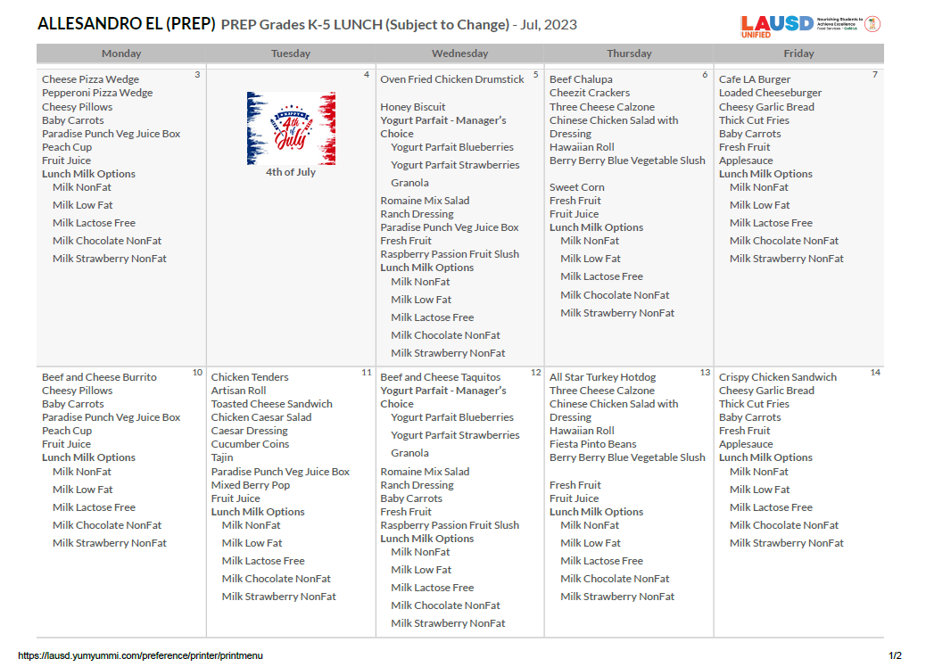
Menu Substitutions
Menus are posted at the point
of service to inform the
students and adults of the
planned menu options.
The substitution will be manually added to indicate menu changes on the posted menus.

Slide 10
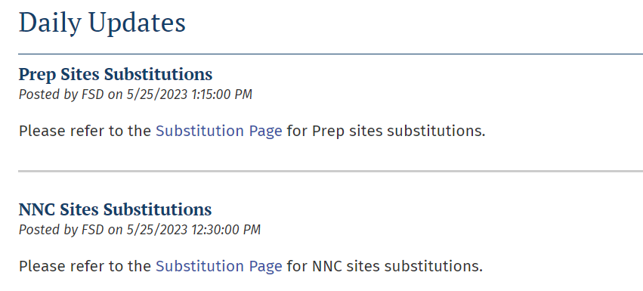
Menu Substitutions
The central office makes menu substitutions for a variety of reasons. When a substitution is made through the central office, they post it through the Daily Updates.
If necessary, shopping lists should be updated so that menu substitutions are ordered
Substitutions should be reflected on the Production Worksheet

Slide 11




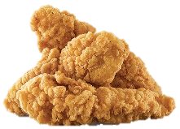

When to Make Substitutions
Cafeteria managers can make menu substitutions for the following reasons:
Substitutions because of missed orders or deliveries.
To use up excess product sitting on shelves or near expiration.
When making substitutions, refer to the Menu Contribution List to ensure the meal pattern requirements are met.

Slide 12
Cross out the item to be substituted and write in the item to be served.
Los Angeles El. (PREP)
Crispy Chicken Filet Sandwich
Note: Substitutions should be made manually with a red pen.

Slide 13
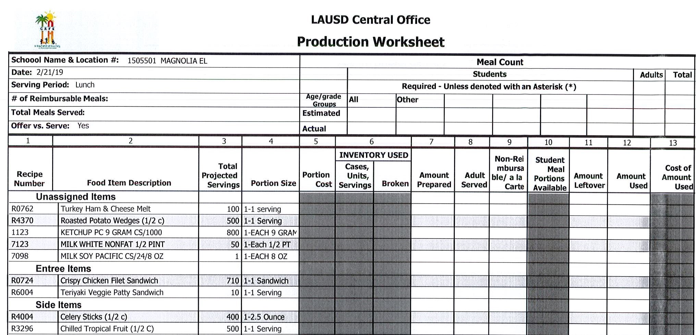



Menu Substitutions
Update the Production Worksheet to reflect the substituted items that will be prepared for service.
Put a line through the item that was not available. Manually write in the substituted food item.
# 11111111 Los Angeles El
8/19/2025
They sent us Chicken Fillet Patties instead of Mini Corn dogs.
Chicken Filet Sandwich
Mini Chicken Corn Dogs
3/17/23
3/17/23
3/17/23
3/17/23
3/17/23
3/17/23
3/17/23
3/17/23
3/17/23
3/17/23

Slide 14
PRODUCTION
WORKSHEET
COLUMNS

Slide 15


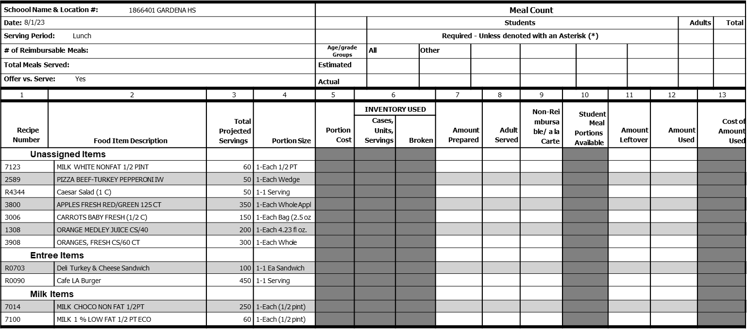

# 11111111 Los Angeles El
8/18/2025
Production
Worksheet
Activity
Comments:
Food Service Worker Signature:
Cafeteria Manager Signature:
Cafeteria Manager, by signing, is certifying that the information on the report is true, correct and in accordance with Food Services policies and procedures.
(c) 2005 Horizon Software International, LLC. All rights reserved.
Production Record Worksheet
Page 1 of 1

Slide 16









# 11111111 Los Angeles El
8/19/2025
1198
ROASTED POTATO WEDGES
Comments:
Food Service Worker Signature:
Cafeteria Manager Signature:
Cafeteria Manager, by signing, is certifying that the information on the report is true, correct and in accordance with Food Services policies and procedures.
(c) 2005 Horizon Software International, LLC. All rights reserved.
Production Record Worksheet
Page 1 of 1

Slide 17


1
Columns 1 Is the recipe and stock number column.
Its important to have all stock and recipe numbers on the production worksheet. This includes any items added onto the production as well.
Recipes
7123
2589
R4344
3800
3006
1198
3908
R0090
Column
Comments:
Food Service Worker Signature:
Cafeteria Manager Signature:
Cafeteria Manager, by signing, is certifying that the information on the report is true, correct and in accordance with Food Services policies and procedures.
(c) 2005 Horizon Software International, LLC. All rights reserved.
Production Record Worksheet
Page 1 of 1

Slide 18


2
3
Total Projected Servings
Columns 2 Is what food items you will prepare for the days service.
Column 3 is the total amount you need to prepare for each item.
Food Item Description
Milk White Non Fat ½ Pint
60
Pizza Beef-Turkey IW
50
Caesar Salad
50
Apples Fresh Red/Green
350
Carrots Baby Fresh (1/2C)
150
Roasted Potato Wedges
200
Oranges Fresh
300
Column
Column
450
Café LA Burger
Comments:
Food Service Worker Signature:
Cafeteria Manager Signature:
Cafeteria Manager, by signing, is certifying that the information on the report is true, correct and in accordance with Food Services policies and procedures.
(c) 2005 Horizon Software International, LLC. All rights reserved.
Production Record Worksheet
Page 1 of 1

Slide 19


7
11
Columns 7 is where you will enter amount prepared.
Column 11 is for leftover amounts after service is complete.
Amount
Prepared
Amount
Leftover
Column
Column
Comments:
Food Service Worker Signature:
Cafeteria Manager Signature:
Cafeteria Manager, by signing, is certifying that the information on the report is true, correct and in accordance with Food Services policies and procedures.
(c) 2005 Horizon Software International, LLC. All rights reserved.
Production Record Worksheet
Page 1 of 1

Slide 20
Who is Responsible for Completing the Production Worksheets?
    Food Service Managers (FSM)
    Senior Food Service Workers (Sr. FSW)
    Food Service Workers (FSW)
    Substitute Food Service Workers (Sub FSW)
    All the Above
All cafeteria personnel must thoroughly understand and be competent in filling out the Production Worksheets.

Slide 21






Assign Staff to Fill-In
Production Worksheet
Instruct staff to write amount prepared and leftovers on the Production Record Worksheet.
Do not use “piece of paper” or verbal methods.
15 - blue
10 - choco
35 - 1%
No Leftovers
8 burrito
1cs Carrot

Slide 22
# 11111111 Los Angeles El
8/18/2025
Production
Worksheet
Activity
Comments:
Food Service Worker Signature:
Cafeteria Manager Signature:
Cafeteria Manager, by signing, is certifying that the information on the report is true, correct and in accordance with Food Services policies and procedures.
(c) 2005 Horizon Software International, LLC. All rights reserved.
Production Record Worksheet
Page 1 of 1

Slide 23


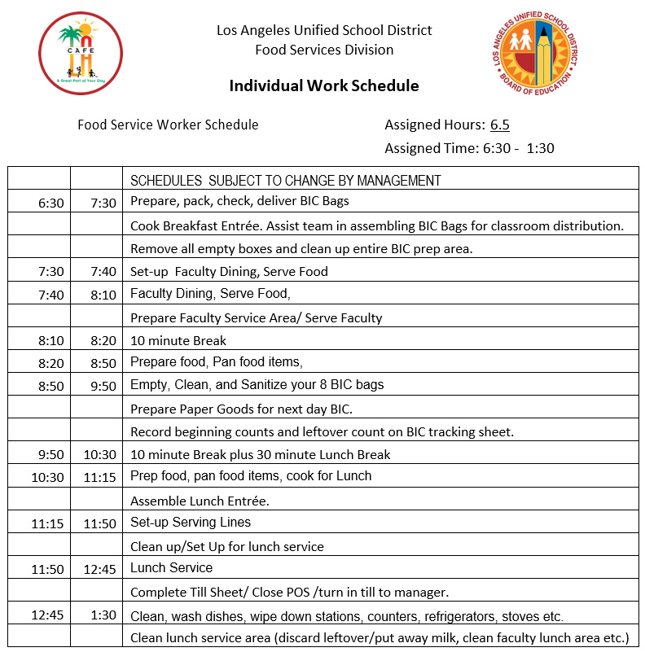


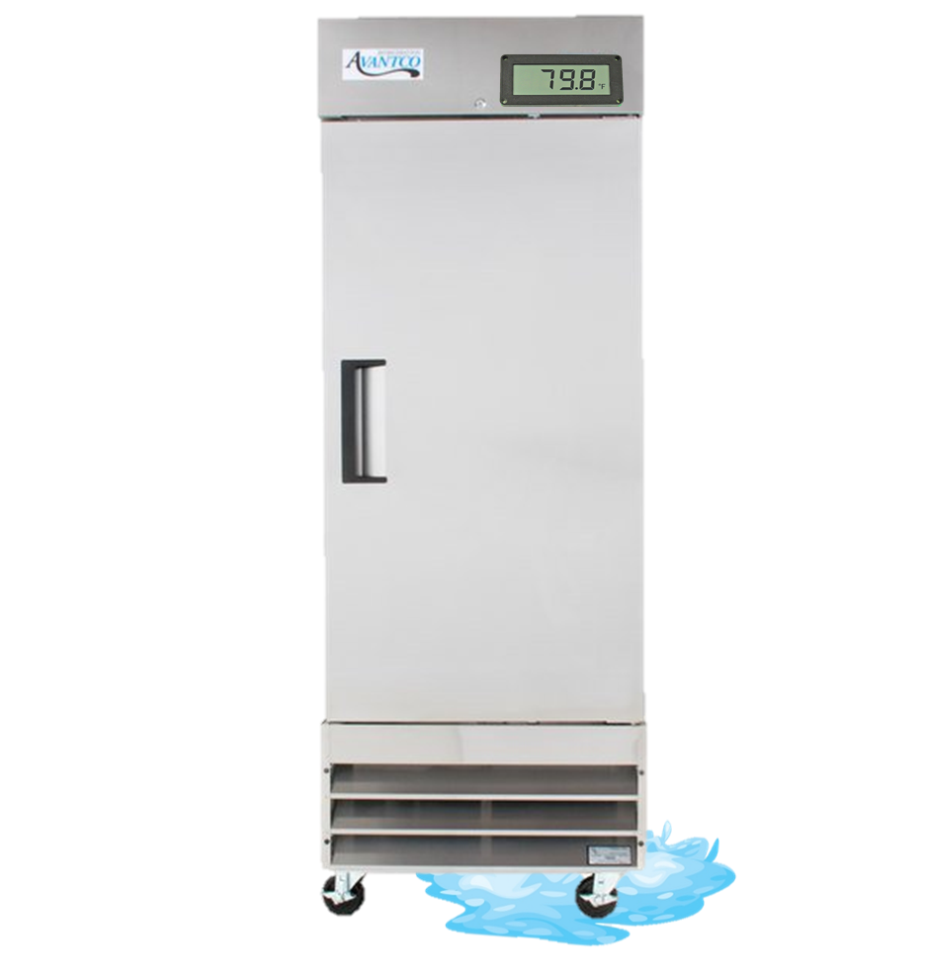







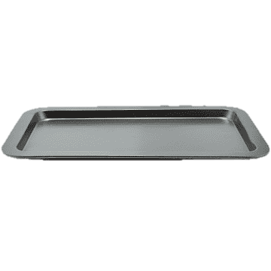



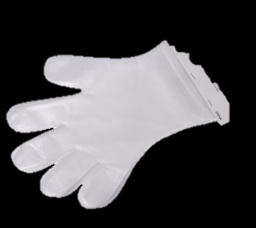

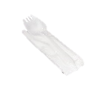







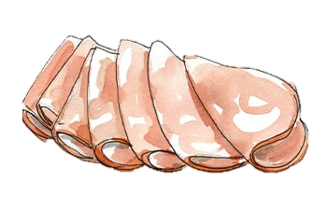
I’ve finished panning 100 sandwiches now I will enter the amount prepared using a pencil in
Column 7
Now let’s prep the Deli Turkey & Cheese Sandwiches and input the prepared amounts in Column 7

Slide 24





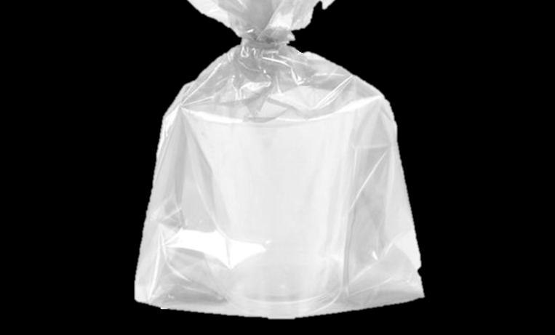


I’ve finished Panning 50 pizzas now I will enter the Amount prepared in
Column 7
Now let’s pan the pizza and input the prepared amounts in Column 7

Slide 25











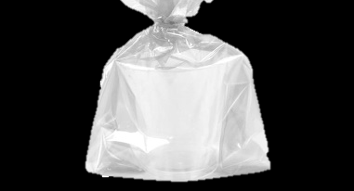
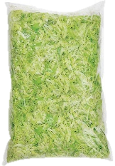
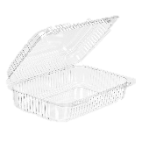
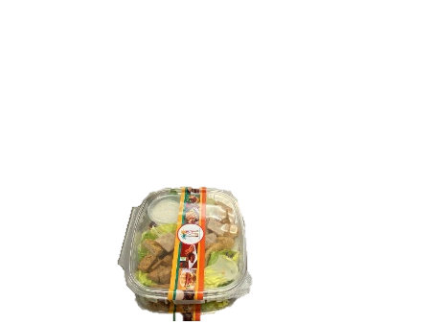
Now let’s prepare the Caesar Salads for the day and input the prepared amounts in Column 7
I’ve prepared 50 Caesar Salads now I will enter the Amount prepared in
Column 7

Slide 26






Now let’s prep the Café LA Burgers and input the prepared amounts in Column 7
I’ve finished panning 450 Café LA Burgers.

Slide 27



I’ve finished Panning 200 Potato Wedges now I will enter the Amount prepared in
Column 7
Now let’s pan the Potato wedges and input the prepared amounts in Column 7

Slide 28





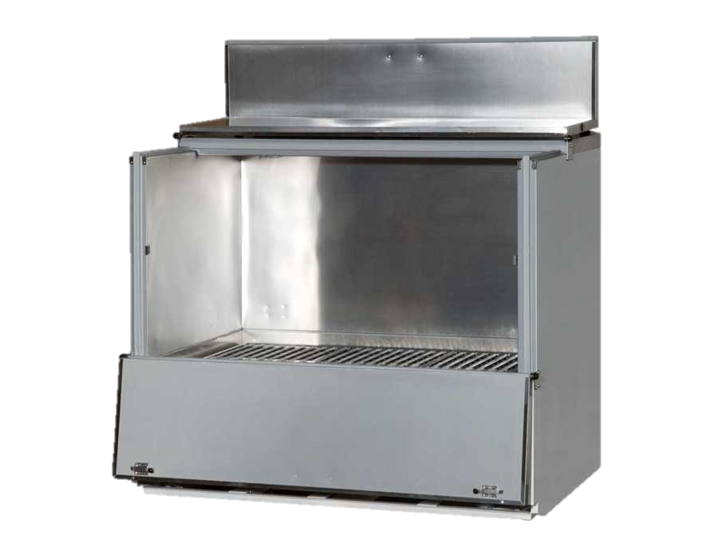
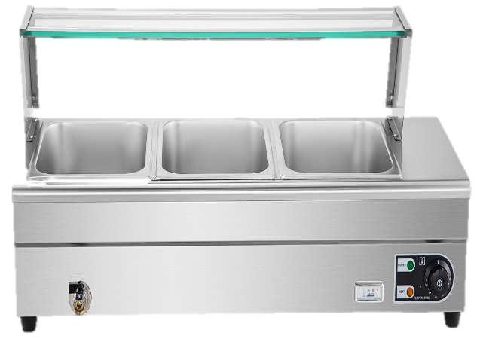



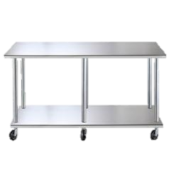
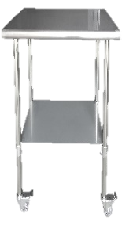





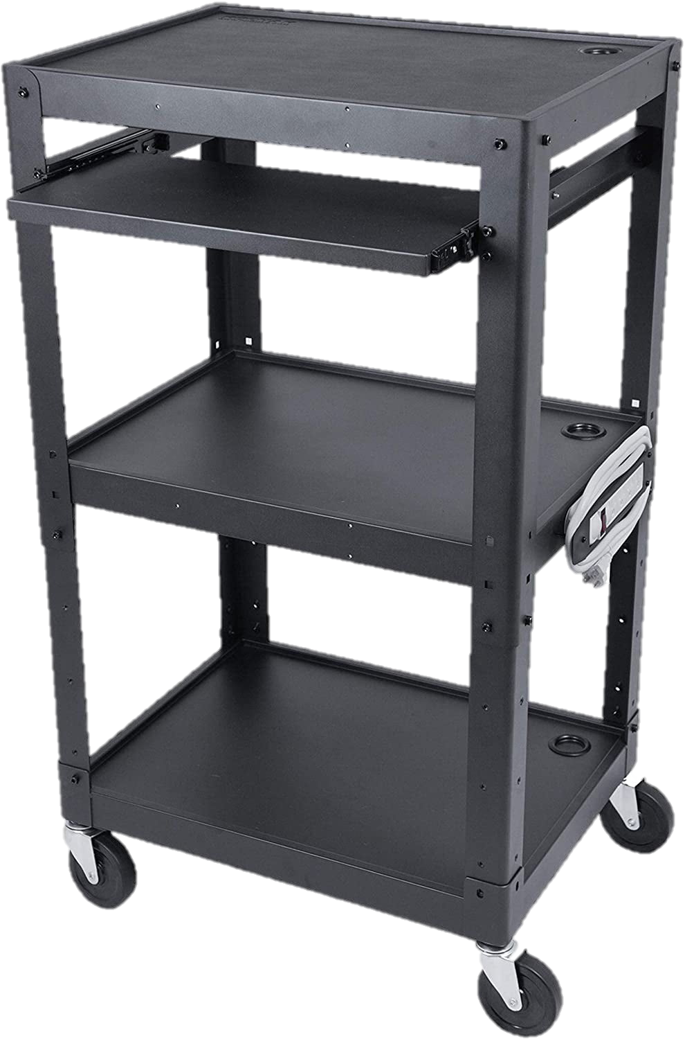

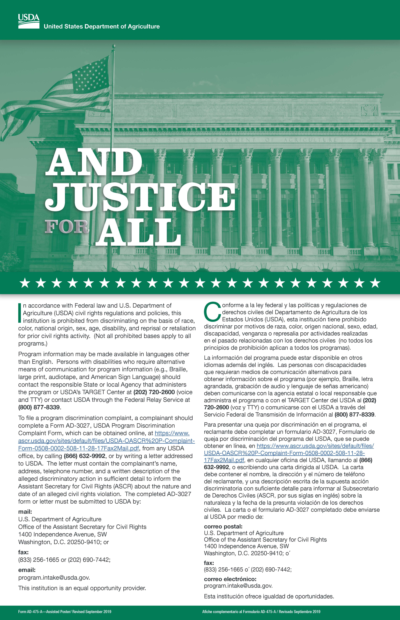


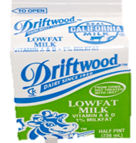
Elementary
Now let’s set up the scramble area for lunch and input the prepared amounts in Column 7

Slide 29





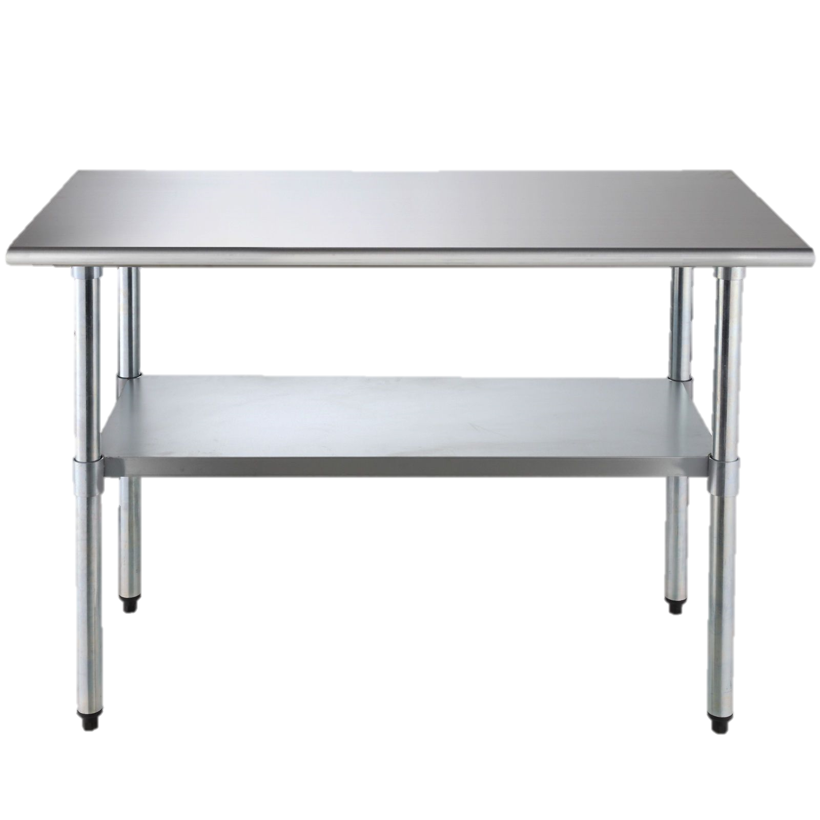



Elementary
Time to add the fruits and vegetables based on the quantities in Column 3 Total Projected Servings.
350
300
150

Slide 30
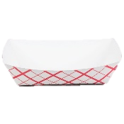





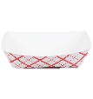

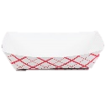
Elementary
Setup your serving line with hot items

Slide 31
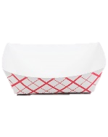




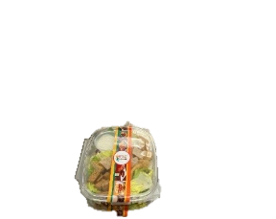




Elementary
Let's setup our cold items.

Slide 32
Following Column 3 Total Projected Servings, fill the beverage cooler with milk for lunch.
Chocolate Milk
250
1 % Low Fat Milk
60
Non-Fat Milk
60

Slide 33

Los Angeles El.
GARDENA HS
Production Worksheet
# 11111111 Los Angeles El
Schoool Name & Location #: 1866401 GARDENA HS |  |  |  |  | Meal Count
Date: 8/1/23 |  |  |  |  |  |  | Students |  |  |  |  |  |  |  |  |  |  |  | Adults |  | Total
Serving Period: Lunch |  |  |  |  |  |  | Required - Unless denoted with an Asterisk (*)
# of Reimbursable Meals: |  |  |  |  | Age/grade Groups |  | All |  | Other
Total Meals Served: |  |  |  |  | Estimated
Offer vs. Serve: Yes |  |  |  |  | Actual
1 | 2 |  | 3 | 4 | 5 | 6 |  |  |  | 7 |  | 8 | 9 | 10 |  | 11 |  | 12 |  | 13
Recipe Number | Food Item Description |  | Total Projected Servings | Portion Size | Portion Cost | INVENTORY USED |  |  |  | Amount Prepared |  | Adult Served | Non-Rei mbursa ble/ a la Carte | Student Meal Portions Available |  | Amount Leftover |  | Amount Used |  | Cost of Amount Used
 |  |  |  |  |  | Cases, Units, Servings |  | Broken
Unassigned Items
7123 |  | MILK WHITE NONFAT 1/2 PINT | 60 | 1-Each 1/2 PT
2589 |  | PIZZA BEEF-TURKEY PEPPERONI IW | 50 | 1-Each Wedge
R4344 |  | Caesar Salad (1 C) | 50 | 1-1 Serving
3800 |  | APPLES FRESH RED/GREEN 125 CT | 350 | 1-Each Whole Appl
3006 |  | CARROTS BABY FRESH (1/2 C) | 150 | 1-Each Bag (2.5 oz
1308 |  | ORANGE MEDLEY JUICE CS/40 | 200 | 1-Each 4.23 fl oz.
3908 |  | ORANGES, FRESH CS/60 CT | 300 | 1-Each Whole
Entree Items
R0703 |  | Deli Turkey & Cheese Sandwich | 100 | 1-1 Ea Sandwich
R0090 |  | Cafe LA Burger | 450 | 1-1 Serving
Milk Items
7014 |  | MILK CHOCO NON FAT 1/2PT | 250 | 1-Each (1/2 pint)
7100 |  | MILK 1 % LOW FAT 1/2 PT ECO | 60 | 1-Each (1/2 pint)
8/19/2025
60
50
50
350
150
1198
Roasted Potato Wedges
200
300
100
450
250
60
Let’s check our progress!
Column 7 is filled out, always double check for accuracy.
Comments:
Cafeteria Manager Signature:
Food Service Worker Signature:
Cafeteria Manager, by signing, is certifying that the information on the report is true, correct and in accordance with Food Services policies and procedures.
(c) 2005 Horizon Software International, LLC. All rights reserved.
Production Record Worksheet
Page 1 of 1

Slide 34
EMPLOYEE
DAILY MEAL
ALLOWANCE

Slide 35
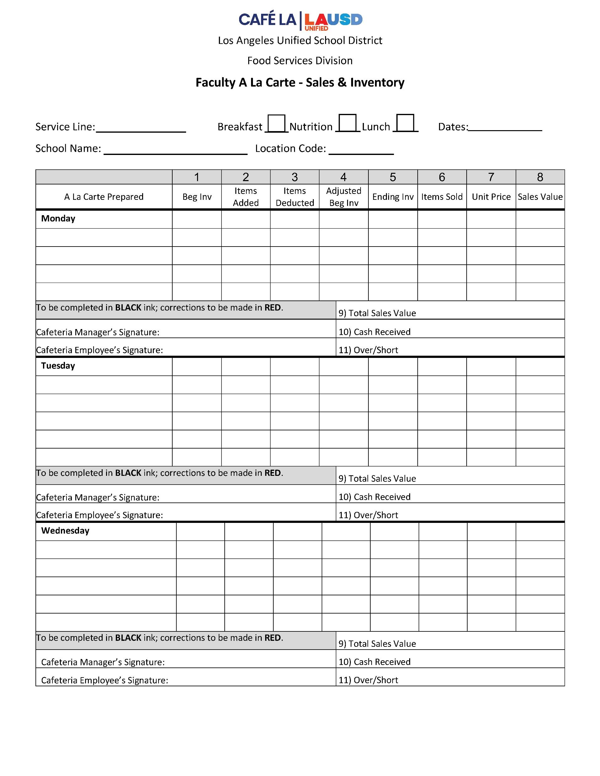
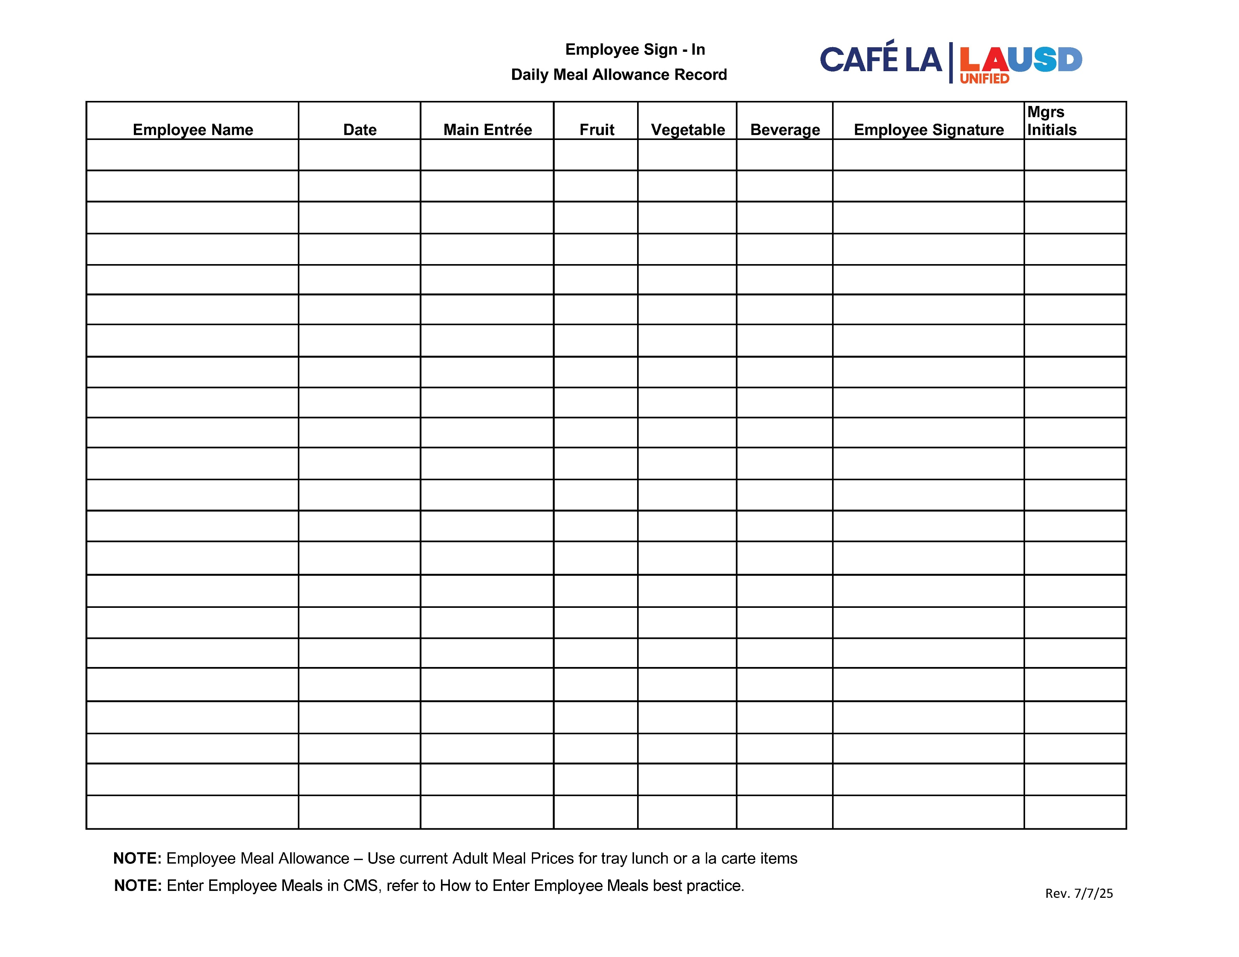
Accounting for Employee Meals
All food service employees are to complete the
Daily Meal Allowance Record Form to record their meals.
    Allowance is one daily meal, either a student tray lunch or breakfast, including one beverage
    All food items must be recorded on column 8 of the Production Record and on the Faculty A La Carte Sales and Inventory Form

Slide 36
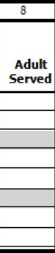
How to Record Adult Meals
Adult meals consist of meals consumed by:
Food service employees
All other adults, other LAUSD employees, parents, or visitors on campus.
All adult meals are recorded in Column 8.
To differentiate between meals served to
adults and employees, draw a line down
Column 8
Label “E” for employee, “A” for adult
E
A
This will help when completing the Meals Revenue tab.

Slide 37

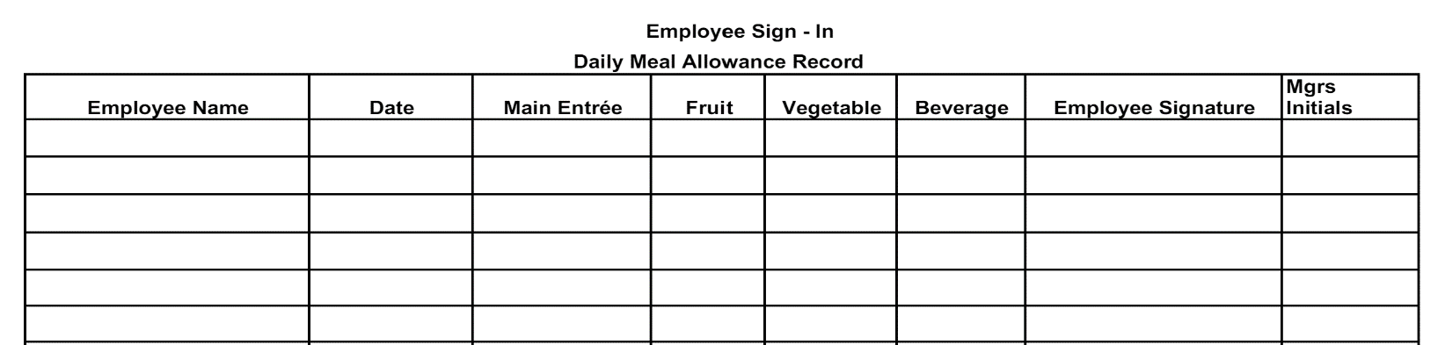









Document employee meals using the Daily Meal Allowance Record.
Document the employee meals in Column 8.
1 Burger
2 Caesar Salads
2 Apples
1 Orange
1 Baby Carrots
1 Potato Wedges
1 Choco Milk
1 (1%) Milk
All food service employees, permanent or substitute and the Food Services Manager are required to complete the “Daily Meal Allowance Record” when consuming food from the cafeteria.
Oswald Gomez V
8/19/2025
Beef Burger
Apple
Baby Carrots
Choco Milk
Oswald Gomez V
O.G.
Kiki Johnson
8/19/2025
Caesar Salad
Apple
1% milk
Kiki Johnson
O.G.
Maria Md
8/19/2025
Caesar Salad
Orange
Wedges
Maria Md
O.G.

Slide 38
# 11111111 Los Angeles El
8/18/2025
Lunch
Service
Begins!!!
Comments:
Food Service Worker Signature:
Cafeteria Manager Signature:
Cafeteria Manager, by signing, is certifying that the information on the report is true, correct and in accordance with Food Services policies and procedures.
(c) 2005 Horizon Software International, LLC. All rights reserved.
Production Record Worksheet
Page 1 of 1

Slide 39

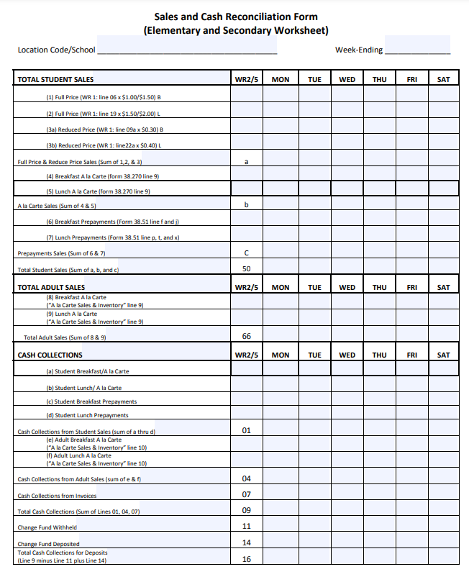

Accounting for Adult Meals
Adult meals can be sold as a la carte or by tray
Charge meals under “Adult” on the POS
  If the adult has an account in MCS, payments can be made through MySchoolBucks
  Record all adult purchases on the Faculty A La Carte Sales and Inventory Form
  Use the Sales and Cash Reconciliation Form to record adult sales for the week
Adult

Slide 40





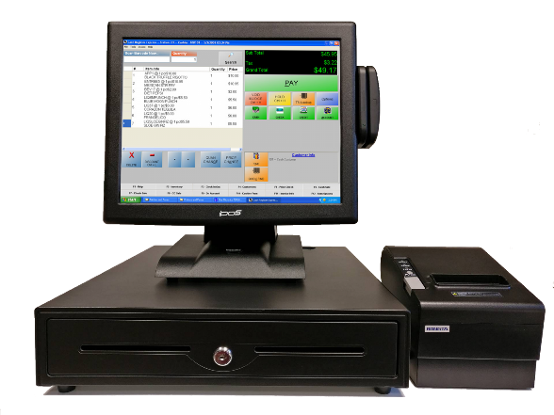









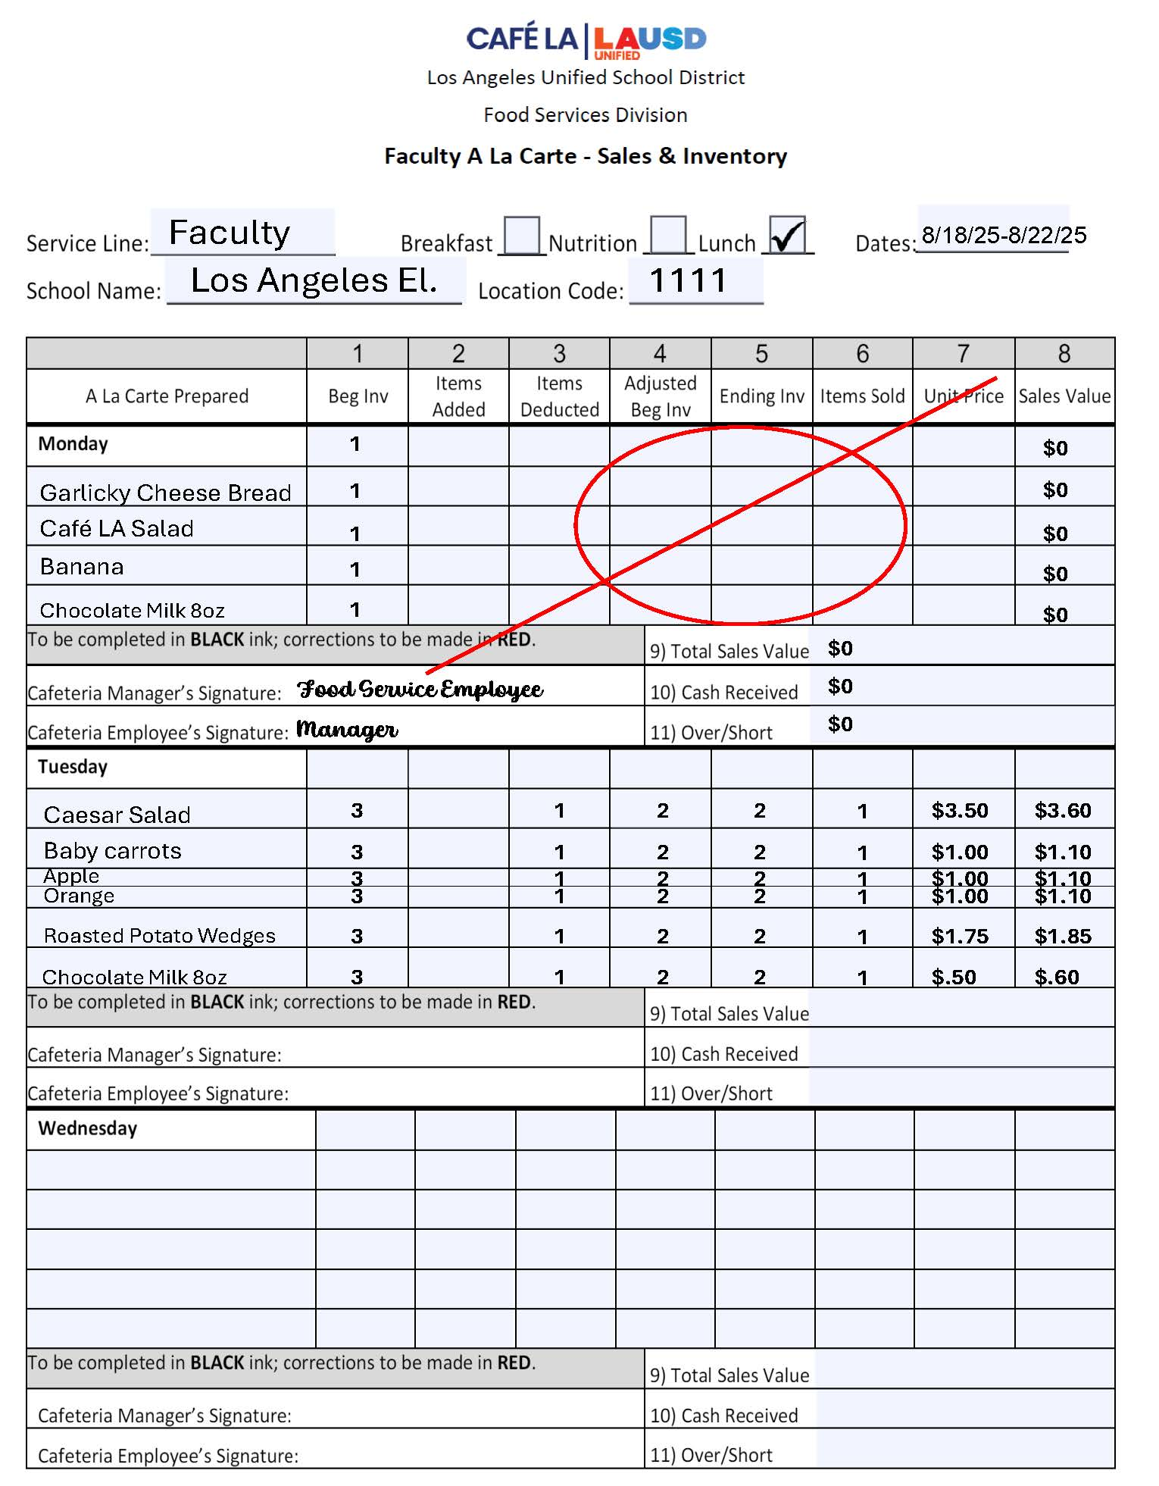
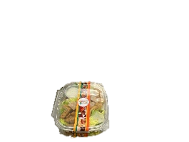
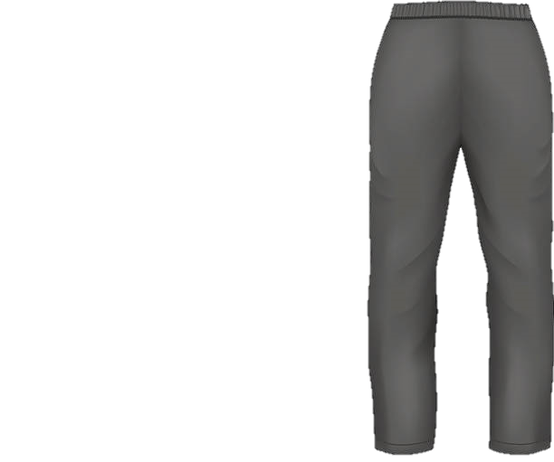


Faculty
Enjoy your meal
Ms. Parker!
Hey, may I please purchase a Caesar Salad, apple, potato wedges, and a chocolate milk.
1 Adult Tray Sold

Slide 41

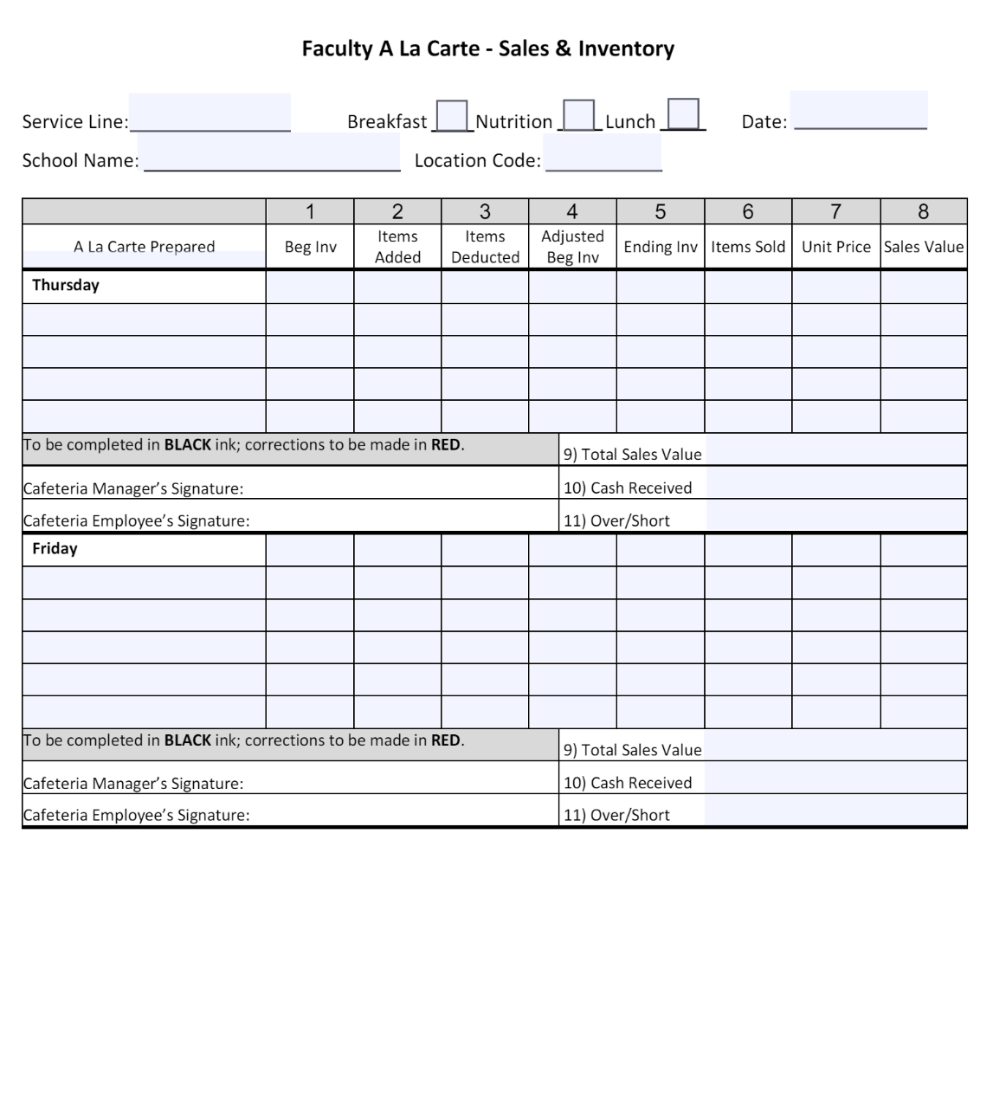
Use the Faculty A La Carte Form to keep track of faculty sales during each service.
8/14/25-8/18/25

Slide 42

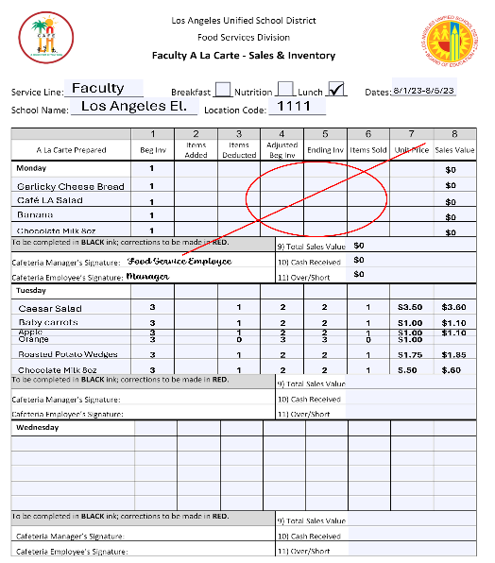
Sure thing
Mr. Clean, enjoy your orange.
Faculty
Hi, can I buy an orange?
1 Orange Sold A La Carte

Slide 43
Use the Faculty A La Carte Form to keep track of faculty sales during each service.

Slide 44








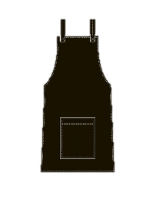








Elementary
Lunch Service

Slide 45
# 11111111 Los Angeles El
8/18/2025
Lunch
Service
Ends!!!
Comments:
Food Service Worker Signature:
Cafeteria Manager Signature:
Cafeteria Manager, by signing, is certifying that the information on the report is true, correct and in accordance with Food Services policies and procedures.
(c) 2005 Horizon Software International, LLC. All rights reserved.
Production Record Worksheet
Page 1 of 1

Slide 46
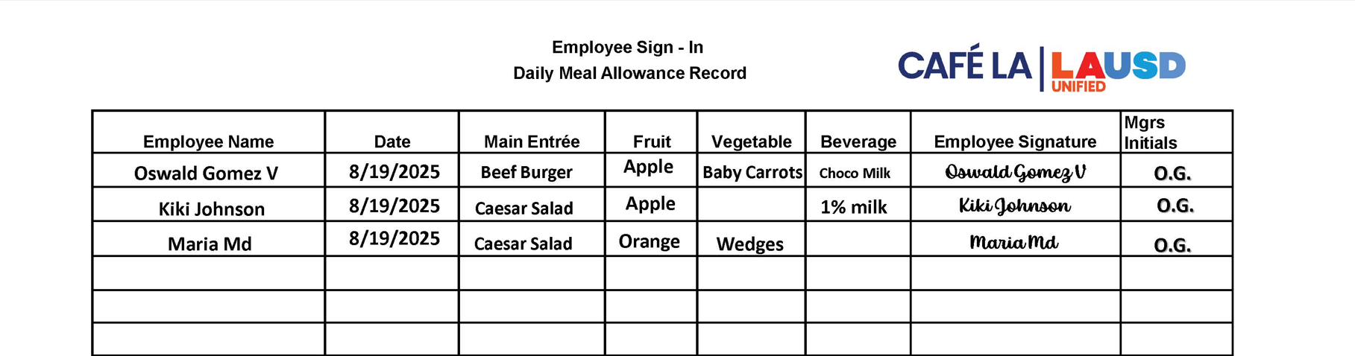

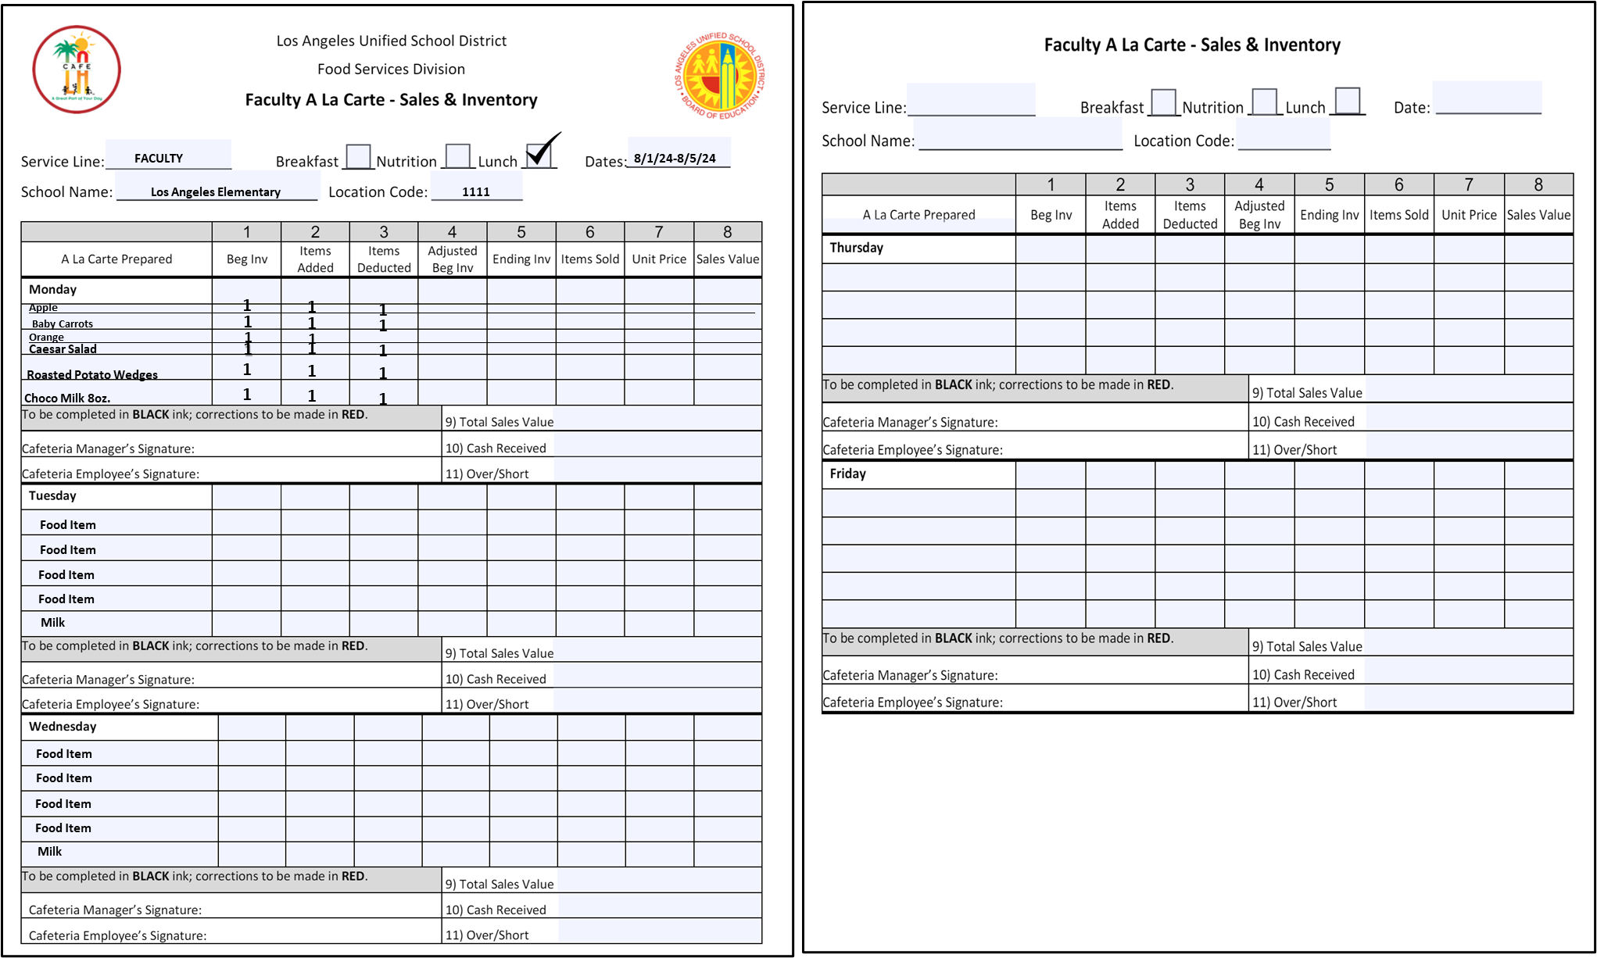
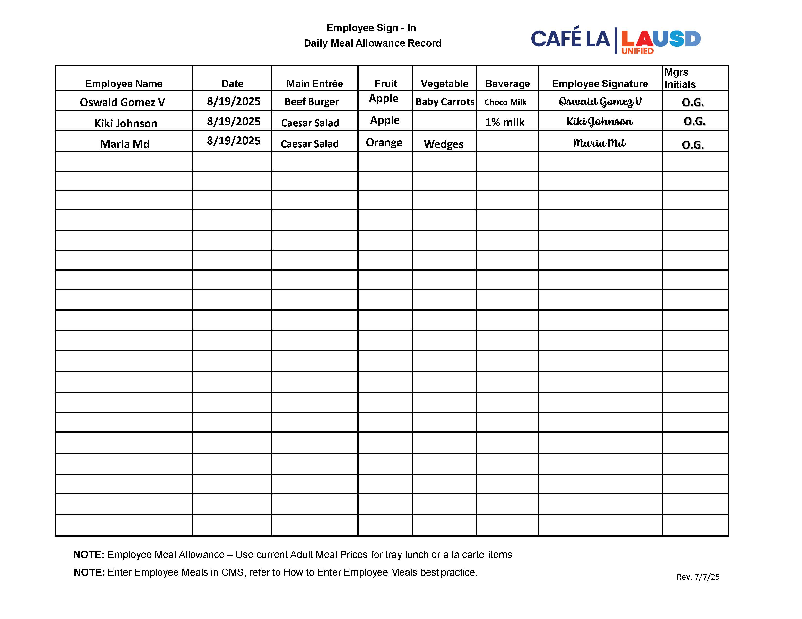

Document the employee meals from the Daily Meal Allowance Record onto the Production Worksheet in Column 8.
Document the adult sales from the Faculty A La Carte Form onto the Production Worksheet in Column 8.
1 Burger
2 Caesar Salads
2 Apples
1 Orange
1 Baby Carrots
1 Potato Wedge
1 Choco Milk
1 (1%) Milk
1 Caesar Salad
1 Potato Wedge
1 Apple
1 Choco Milk
A La Carte
1 Orange

Slide 47
Los Angeles El.
GARDENA HS
Production Worksheet
# 11111111 Los Angeles El
Schoool Name & Location #: 1866401 GARDENA HS |  |  |  |  | Meal Count
Date: 8/1/23 |  |  |  |  |  |  | Students |  |  |  |  |  |  |  |  |  |  |  | Adults |  | Total
Serving Period: Lunch |  |  |  |  |  |  | Required - Unless denoted with an Asterisk (*)
# of Reimbursable Meals: |  |  |  |  | Age/grade Groups |  | All |  | Other
Total Meals Served: |  |  |  |  | Estimated
Offer vs. Serve: Yes |  |  |  |  | Actual
1 | 2 |  | 3 | 4 | 5 | 6 |  |  |  | 7 |  | 8 | 9 | 10 |  | 11 |  | 12 |  | 13
Recipe Number | Food Item Description |  | Total Projected Servings | Portion Size | Portion Cost | INVENTORY USED |  |  |  | Amount Prepared |  | Adult Served | Non-Rei mbursa ble/ a la Carte | Student Meal Portions Available |  | Amount Leftover |  | Amount Used |  | Cost of Amount Used
 |  |  |  |  |  | Cases, Units, Servings |  | Broken
Unassigned Items
7123 |  | MILK WHITE NONFAT 1/2 PINT | 60 | 1-Each 1/2 PT
2589 |  | PIZZA BEEF-TURKEY PEPPERONI IW | 50 | 1-Each Wedge
R4344 |  | Caesar Salad (1 C) | 50 | 1-1 Serving
3800 |  | APPLES FRESH RED/GREEN 125 CT | 350 | 1-Each Whole Appl
3006 |  | CARROTS BABY FRESH (1/2 C) | 150 | 1-Each Bag (2.5 oz
1308 |  | ORANGE MEDLEY JUICE CS/40 | 200 | 1-Each 4.23 fl oz.
3908 |  | ORANGES, FRESH CS/60 CT | 300 | 1-Each Whole
Entree Items
R0703 |  | Deli Turkey & Cheese Sandwich | 100 | 1-1 Ea Sandwich
R0090 |  | Cafe LA Burger | 450 | 1-1 Serving
Milk Items
7014 |  | MILK CHOCO NON FAT 1/2PT | 250 | 1-Each (1/2 pint)
7100 |  | MILK 1 % LOW FAT 1/2 PT ECO | 60 | 1-Each (1/2 pint)
8/19/2025
E
A
60
50
1
50
2
350
2
1
150
1
1198
Roasted Potato Wedges
200
1
300
1
1
100
450
1
250
1
1
60
1
Using the Daily Meal Allowance Record
Column 8 is filled out, when employees eat a meal.
Comments:
Cafeteria Manager Signature:
Food Service Worker Signature:
Cafeteria Manager, by signing, is certifying that the information on the report is true, correct and in accordance with Food Services policies and procedures.
(c) 2005 Horizon Software International, LLC. All rights reserved.
Production Record Worksheet
Page 1 of 1

Slide 48



Ohhhh! I see 5 empty trays, looks like some customers took double the
roasted potato wedges.
Let’s add those to
Column 9.
5 Non-Reimbursable potato wedges

Slide 49


Leftovers
Leftovers From Lunch
Now we count the leftovers from lunch and input the leftover amounts in
Column 11
2 -Pizza
5 -Apples
5 –Oranges
1 -LF 1% Milk
3 -Caesar Salad
3 –Café LA Burgers
5 -Baby Carrots
3 –Non-Fat Milk
3 -Chocolate Milk
3 -Deli Turkey Sandwich
2 –Roasted Potato Wedges

Slide 50
GARDENA HS
Production Worksheet
Los Angeles El.
# 11111111 Los Angeles El
Schoool Name & Location #: 1866401 GARDENA HS |  |  |  |  | Meal Count
Date: 8/1/23 |  |  |  |  |  |  | Students |  |  |  |  |  |  |  |  |  |  |  | Adults |  | Total
Serving Period: Lunch |  |  |  |  |  |  | Required - Unless denoted with an Asterisk (*)
# of Reimbursable Meals: |  |  |  |  | Age/grade Groups |  | All |  | Other
Total Meals Served: |  |  |  |  | Estimated
Offer vs. Serve: Yes |  |  |  |  | Actual
1 | 2 |  | 3 | 4 | 5 | 6 |  |  |  | 7 |  | 8 | 9 | 10 |  | 11 |  | 12 |  | 13
Recipe Number | Food Item Description |  | Total Projected Servings | Portion Size | Portion Cost | INVENTORY USED |  |  |  | Amount Prepared |  | Adult Served | Non-Rei mbursa ble/ a la Carte | Student Meal Portions Available |  | Amount Leftover |  | Amount Used |  | Cost of Amount Used
 |  |  |  |  |  | Cases, Units, Servings |  | Broken
Unassigned Items
7123 |  | MILK WHITE NONFAT 1/2 PINT | 60 | 1-Each 1/2 PT
2589 |  | PIZZA BEEF-TURKEY PEPPERONI IW | 50 | 1-Each Wedge
R4344 |  | Caesar Salad (1 C) | 50 | 1-1 Serving
3800 |  | APPLES FRESH RED/GREEN 125 CT | 350 | 1-Each Whole Appl
3006 |  | CARROTS BABY FRESH (1/2 C) | 150 | 1-Each Bag (2.5 oz
1308 |  | ORANGE MEDLEY JUICE CS/40 | 200 | 1-Each 4.23 fl oz.
3908 |  | ORANGES, FRESH CS/60 CT | 300 | 1-Each Whole
Entree Items
R0703 |  | Deli Turkey & Cheese Sandwich | 100 | 1-1 Ea Sandwich
R0090 |  | Cafe LA Burger | 450 | 1-1 Serving
Milk Items
7014 |  | MILK CHOCO NON FAT 1/2PT | 250 | 1-Each (1/2 pint)
7100 |  | MILK 1 % LOW FAT 1/2 PT ECO | 60 | 1-Each (1/2 pint)
8/19/2025
E
A
60
3
50
2
50
2
1
3
350
2
1
5
150
1
5
1198
Roasted Potato Wedges
200
1
5
2
300
1
1
5
100
3
450
1
3
250
1
1
3
60
1
1
1 Adult tray sold ( 1 Caesar Salad, 1 apple, 1 roasted potato wedge, and 1 chocolate milk).Entered in Column8.
5 Potato wedges & 1 orange will be entered in Column 9.
Column 8: Input Number of Employees & Adult Customers who purchased or received a Full Meal.
Column 9: Input the number of A LA Carte Sales and items that are burned or non-reimbursable.
Comments:
Cafeteria Manager Signature:
Food Service Worker Signature:
Cafeteria Manager, by signing, is certifying that the information on the report is true, correct and in accordance with Food Services policies and procedures.
(c) 2005 Horizon Software International, LLC. All rights reserved.
Production Record Worksheet
Page 1 of 1

Slide 51
Los Angeles El.
GARDENA HS
Production Worksheet
# 11111111 Los Angeles El
Schoool Name & Location #: 1866401 GARDENA HS |  |  |  |  | Meal Count
Date: 8/1/23 |  |  |  |  |  |  | Students |  |  |  |  |  |  |  |  |  |  |  | Adults |  | Total
Serving Period: Lunch |  |  |  |  |  |  | Required - Unless denoted with an Asterisk (*)
# of Reimbursable Meals: |  |  |  |  | Age/grade Groups |  | All |  | Other
Total Meals Served: |  |  |  |  | Estimated
Offer vs. Serve: Yes |  |  |  |  | Actual
1 | 2 |  | 3 | 4 | 5 | 6 |  |  |  | 7 |  | 8 | 9 | 10 |  | 11 |  | 12 |  | 13
Recipe Number | Food Item Description |  | Total Projected Servings | Portion Size | Portion Cost | INVENTORY USED |  |  |  | Amount Prepared |  | Adult Served | Non-Rei mbursa ble/ a la Carte | Student Meal Portions Available |  | Amount Leftover |  | Amount Used |  | Cost of Amount Used
 |  |  |  |  |  | Cases, Units, Servings |  | Broken
Unassigned Items
7123 |  | MILK WHITE NONFAT 1/2 PINT | 60 | 1-Each 1/2 PT
2589 |  | PIZZA BEEF-TURKEY PEPPERONI IW | 50 | 1-Each Wedge
R4344 |  | Caesar Salad (1 C) | 50 | 1-1 Serving
3800 |  | APPLES FRESH RED/GREEN 125 CT | 350 | 1-Each Whole Appl
3006 |  | CARROTS BABY FRESH (1/2 C) | 150 | 1-Each Bag (2.5 oz
1308 |  | ORANGE MEDLEY JUICE CS/40 | 200 | 1-Each 4.23 fl oz.
3908 |  | ORANGES, FRESH CS/60 CT | 300 | 1-Each Whole
Entree Items
R0703 |  | Deli Turkey & Cheese Sandwich | 100 | 1-1 Ea Sandwich
R0090 |  | Cafe LA Burger | 450 | 1-1 Serving
Milk Items
7014 |  | MILK CHOCO NON FAT 1/2PT | 250 | 1-Each (1/2 pint)
7100 |  | MILK 1 % LOW FAT 1/2 PT ECO | 60 | 1-Each (1/2 pint)
8/19/2025
E
A
60
3
57
50
2
48
50
2
1
3
47
350
2
1
5
345
150
1
5
145
1198
Roasted Potato Wedges
200
1
5
2
198
300
1
1
5
295
100
3
97
450
1
3
447
250
1
1
3
247
60
1
1
59
Column 12: Amount Used is calculated by using simple subtraction math. CMS will automatically fill in when input into OneSource.
Comments:
Cafeteria Manager Signature:
Food Service Worker Signature:
Cafeteria Manager, by signing, is certifying that the information on the report is true, correct and in accordance with Food Services policies and procedures.
(c) 2005 Horizon Software International, LLC. All rights reserved.
Production Record Worksheet
Page 1 of 1

Slide 52
Los Angeles El.
GARDENA HS
Production Worksheet
# 11111111 Los Angeles El
Schoool Name & Location #: 1866401 GARDENA HS |  |  |  |  | Meal Count
Date: 8/1/23 |  |  |  |  |  |  | Students |  |  |  |  |  |  |  |  |  |  |  | Adults |  | Total
Serving Period: Lunch |  |  |  |  |  |  | Required - Unless denoted with an Asterisk (*)
# of Reimbursable Meals: |  |  |  |  | Age/grade Groups |  | All |  | Other
Total Meals Served: |  |  |  |  | Estimated
Offer vs. Serve: Yes |  |  |  |  | Actual
1 | 2 |  | 3 | 4 | 5 | 6 |  |  |  | 7 |  | 8 | 9 | 10 |  | 11 |  | 12 |  | 13
Recipe Number | Food Item Description |  | Total Projected Servings | Portion Size | Portion Cost | INVENTORY USED |  |  |  | Amount Prepared |  | Adult Served | Non-Rei mbursa ble/ a la Carte | Student Meal Portions Available |  | Amount Leftover |  | Amount Used |  | Cost of Amount Used
 |  |  |  |  |  | Cases, Units, Servings |  | Broken
Unassigned Items
7123 |  | MILK WHITE NONFAT 1/2 PINT | 60 | 1-Each 1/2 PT
2589 |  | PIZZA BEEF-TURKEY PEPPERONI IW | 50 | 1-Each Wedge
R4344 |  | Caesar Salad (1 C) | 50 | 1-1 Serving
3800 |  | APPLES FRESH RED/GREEN 125 CT | 350 | 1-Each Whole Appl
3006 |  | CARROTS BABY FRESH (1/2 C) | 150 | 1-Each Bag (2.5 oz
1308 |  | ORANGE MEDLEY JUICE CS/40 | 200 | 1-Each 4.23 fl oz.
3908 |  | ORANGES, FRESH CS/60 CT | 300 | 1-Each Whole
Entree Items
R0703 |  | Deli Turkey & Cheese Sandwich | 100 | 1-1 Ea Sandwich
R0090 |  | Cafe LA Burger | 450 | 1-1 Serving
Milk Items
7014 |  | MILK CHOCO NON FAT 1/2PT | 250 | 1-Each (1/2 pint)
7100 |  | MILK 1 % LOW FAT 1/2 PT ECO | 60 | 1-Each (1/2 pint)
8/19/2025
E
A
60
3
57
50
2
48
50
2
1
3
47
350
2
1
5
345
150
1
5
145
1198
Roasted Potato Wedges
200
1
5
2
198
300
1
1
5
295
100
3
97
450
1
3
447
250
1
1
3
247
60
1
1
59
Senior or staff will sign their first or last name with a pen and turn into manager for final review and submission.
Comments:
Gomez Adams
Cafeteria Manager Signature:
Food Service Worker Signature:
Cafeteria Manager, by signing, is certifying that the information on the report is true, correct and in accordance with Food Services policies and procedures.
(c) 2005 Horizon Software International, LLC. All rights reserved.
Production Record Worksheet
Page 1 of 1

Slide 53
Los Angeles El.
GARDENA HS
Production Worksheet
# 11111111 Los Angeles El
# 11111111 Los Angeles El
Schoool Name & Location #: 1866401 GARDENA HS |  |  |  |  | Meal Count
Date: 8/1/23 |  |  |  |  |  |  | Students |  |  |  |  |  |  |  |  |  |  |  | Adults |  | Total
Serving Period: Lunch |  |  |  |  |  |  | Required - Unless denoted with an Asterisk (*)
# of Reimbursable Meals: |  |  |  |  | Age/grade Groups |  | All |  | Other
Total Meals Served: |  |  |  |  | Estimated
Offer vs. Serve: Yes |  |  |  |  | Actual
1 | 2 |  | 3 | 4 | 5 | 6 |  |  |  | 7 |  | 8 | 9 | 10 |  | 11 |  | 12 |  | 13
Recipe Number | Food Item Description |  | Total Projected Servings | Portion Size | Portion Cost | INVENTORY USED |  |  |  | Amount Prepared |  | Adult Served | Non-Rei mbursa ble/ a la Carte | Student Meal Portions Available |  | Amount Leftover |  | Amount Used |  | Cost of Amount Used
 |  |  |  |  |  | Cases, Units, Servings |  | Broken
Unassigned Items
7123 |  | MILK WHITE NONFAT 1/2 PINT | 60 | 1-Each 1/2 PT
2589 |  | PIZZA BEEF-TURKEY PEPPERONI IW | 50 | 1-Each Wedge
R4344 |  | Caesar Salad (1 C) | 50 | 1-1 Serving
3800 |  | APPLES FRESH RED/GREEN 125 CT | 350 | 1-Each Whole Appl
3006 |  | CARROTS BABY FRESH (1/2 C) | 150 | 1-Each Bag (2.5 oz
1308 |  | ORANGE MEDLEY JUICE CS/40 | 200 | 1-Each 4.23 fl oz.
3908 |  | ORANGES, FRESH CS/60 CT | 300 | 1-Each Whole
Entree Items
R0703 |  | Deli Turkey & Cheese Sandwich | 100 | 1-1 Ea Sandwich
R0090 |  | Cafe LA Burger | 450 | 1-1 Serving
Milk Items
7014 |  | MILK CHOCO NON FAT 1/2PT | 250 | 1-Each (1/2 pint)
7100 |  | MILK 1 % LOW FAT 1/2 PT ECO | 60 | 1-Each (1/2 pint)
8/19/2025
592
596
E
A
60
3
57
50
2
48
50
2
1
3
47
350
1
5
345
150
1
5
145
1198
Roasted Potato Wedges
200
1
5
2
198
300
1
1
5
295
100
3
97
455
1
3
447
250
1
1
3
247
60
1
1
59
Comments:
Managers must write down comments reflecting what occurred during lunch service.
3 Employees ate a lunch meal (2-Caesar salads, 1-burger, 1-potato wedges, 1-apple, 1-orange,
1-Chocolate milk, and 1-1% milk.)
1 Adult Tray Sold ( 1-Caesar Salad, 1-Apple, 1-Roasted Potato Wedge, 1-Chocolate milk)
1 Orange Sold A La Carte
5 Non-reimbursable Roasted Potato Wedges Due To Theft
Food Service Worker Signature:
Gomez Adams
Cafeteria Manager Signature:
Cafeteria Manager, by signing, is certifying that the information on the report is true, correct and in accordance with Food Services policies and procedures.
(c) 2005 Horizon Software International, LLC. All rights reserved.
Production Record Worksheet
Page 1 of 1

Slide 54


Production Worksheet Signature
When the Production Worksheet is complete, it is signed by:
  Food Service Worker/Senior Worker/Designee
  Food Service Manager
Los Angeles El
By signing the Production Worksheet, the FSM is certifying that the information on the report is true, correct and in accordance with Food Services Policies and Procedures.
Los Angeles El
F. Garcia
Anthony Gomez III.

Slide 55
Los Angeles El.
GARDENA HS
Production Worksheet
# 11111111 Los Angeles El
# 11111111 Los Angeles El
Schoool Name & Location #: 1866401 GARDENA HS |  |  |  |  | Meal Count
Date: 8/1/23 |  |  |  |  |  |  | Students |  |  |  |  |  |  |  |  |  |  |  | Adults |  | Total
Serving Period: Lunch |  |  |  |  |  |  | Required - Unless denoted with an Asterisk (*)
# of Reimbursable Meals: |  |  |  |  | Age/grade Groups |  | All |  | Other
Total Meals Served: |  |  |  |  | Estimated
Offer vs. Serve: Yes |  |  |  |  | Actual
1 | 2 |  | 3 | 4 | 5 | 6 |  |  |  | 7 |  | 8 | 9 | 10 |  | 11 |  | 12 |  | 13
Recipe Number | Food Item Description |  | Total Projected Servings | Portion Size | Portion Cost | INVENTORY USED |  |  |  | Amount Prepared |  | Adult Served | Non-Rei mbursa ble/ a la Carte | Student Meal Portions Available |  | Amount Leftover |  | Amount Used |  | Cost of Amount Used
 |  |  |  |  |  | Cases, Units, Servings |  | Broken
Unassigned Items
7123 |  | MILK WHITE NONFAT 1/2 PINT | 60 | 1-Each 1/2 PT
2589 |  | PIZZA BEEF-TURKEY PEPPERONI IW | 50 | 1-Each Wedge
R4344 |  | Caesar Salad (1 C) | 50 | 1-1 Serving
3800 |  | APPLES FRESH RED/GREEN 125 CT | 350 | 1-Each Whole Appl
3006 |  | CARROTS BABY FRESH (1/2 C) | 150 | 1-Each Bag (2.5 oz
1308 |  | ORANGE MEDLEY JUICE CS/40 | 200 | 1-Each 4.23 fl oz.
3908 |  | ORANGES, FRESH CS/60 CT | 300 | 1-Each Whole
Entree Items
R0703 |  | Deli Turkey & Cheese Sandwich | 100 | 1-1 Ea Sandwich
R0090 |  | Cafe LA Burger | 450 | 1-1 Serving
Milk Items
7014 |  | MILK CHOCO NON FAT 1/2PT | 250 | 1-Each (1/2 pint)
7100 |  | MILK 1 % LOW FAT 1/2 PT ECO | 60 | 1-Each (1/2 pint)
8/19/2025
592
593
E
A
60
3
57
50
2
48
50
2
1
3
47
350
1
5
345
150
1
5
145
1198
Roasted Potato Wedges
200
1
5
2
198
300
1
1
5
295
100
3
97
455
1
3
447
250
1
1
3
247
60
1
1
59
Manager will then sign the production work sheet with a pen and file in Folder #1 following record and retention guidelines.
Comments:
Gomez Adams
You The Amazing Manager
Food Service Worker Signature:
Cafeteria Manager Signature:
Cafeteria Manager, by signing, is certifying that the information on the report is true, correct and in accordance with Food Services policies and procedures.
(c) 2005 Horizon Software International, LLC. All rights reserved.
Production Record Worksheet
Page 1 of 1

Slide 56
Recap
Who's responsible for entering information into the Production Worksheet?
All cafeteria staff is responsible for completing Production Worksheets.
Why is it crucial to ensure that the Production Worksheets and Production Records are accurate and complete daily?
The entered information supports the claim for reimbursements from the state and federal government.
What is a Production Record?
Production Records help plan menus, predict quantities, minimize waste, choose suitable options, and analyze nutrients.

Slide 57
Thank You

